Slide 1
Health Condition 0 Source Domain
Health Condition 1 Source Domain
Source Domain Classifier
Health Condition 0 Target Domain
Without Domain Adaptation
Health Condition 1 Target Domain
Misclassified Sample
Source Domain
Domain-Invariant Feature Space
Source Domain Classifier
Cross- Domain Classifier
Target Domain
With Domain Adaptation

Slide 2
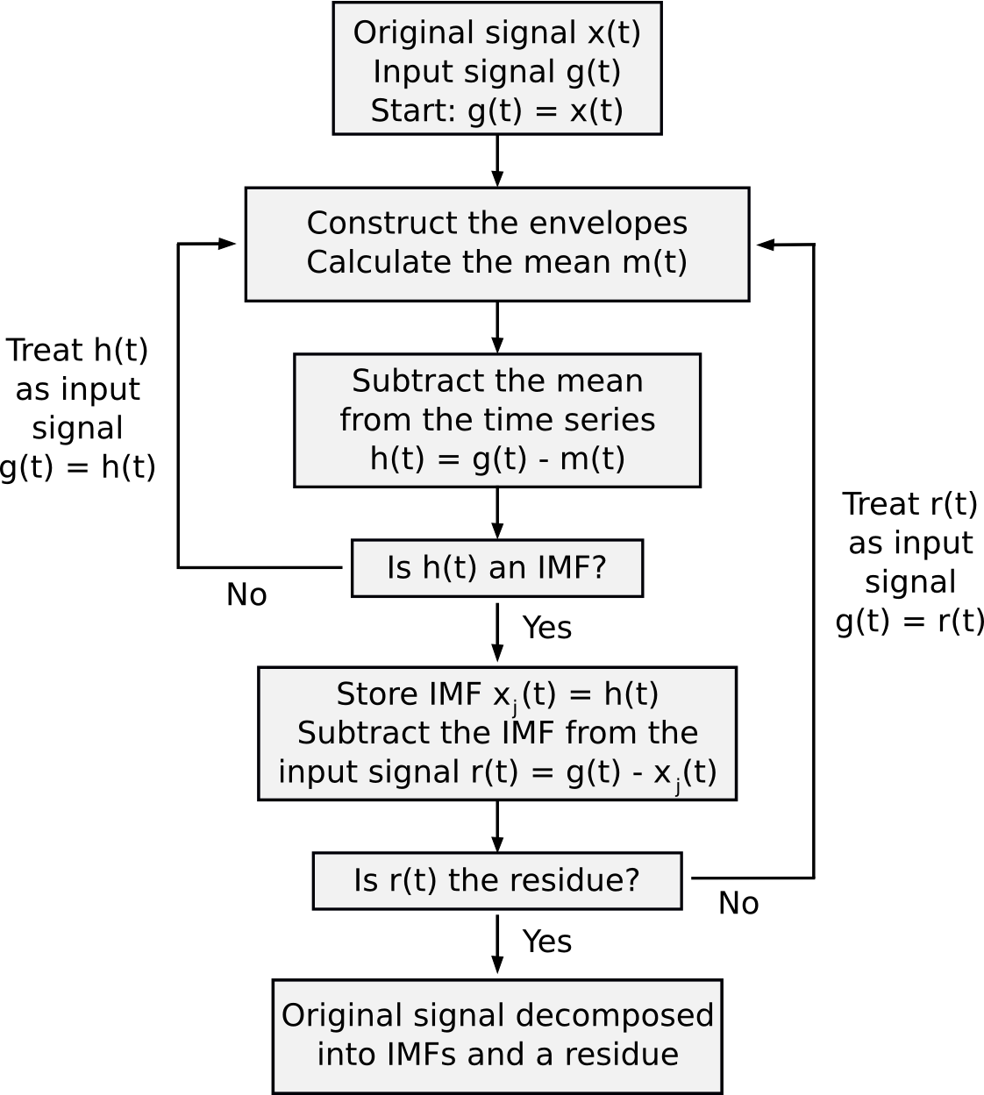

Slide 3
3x1x1024
64x1x925
64x1x308
32x1x301
32x1x301
32x1x100
32x1x98
32x1x98
1x1x3136
1x1x2
1x1x100
1x100
1x4
1x10
1x4
1x5
Conv
Max-Pool
Conv
Batch-Norm
Max-Pool
Conv
Batch-Norm
Flatten
FC
FC

Slide 4
3x1x1000
64x1x901
64x1x300
32x1x293
32x1x293
32x1x97
32x1x95
32x1x95
32x1x31
1x1x992
1x1x100
1x1x3
1x1x2
1x100
1x4
1x10
1x5
1x5
1x5
Conv
Max-Pool
Conv
Batch-Norm
Max-Pool
Conv
Batch-Norm
Max-Pool
Flatten
FC
FC
FC
https://github.com/HarisIqbal88/PlotNeuralNet
https://github.com/ashishpatel26/Tools-to-Design-or-Visualize-Architecture-of-Neural-Network

Slide 5
Labeled Source Domain
Unlabeled Target Domain
Health Condition 0
Health Condition 1
Data Pre-Processing and Sample Generation
Design Model Architecture
Obtain Latent Feature Spaces from Target and Source Samples
Predict Health Condition Classes for Source Domain
Calculate Multi-Layer MMD Loss
Calculate CE Loss
Obtain Total Loss
Train Model with Optimizer 1 with the Total Loss
Train FC2 and FC3 with Optimizer 2 with the CE Loss
No
Maximum Epochs ?
Yes
Trained Model
Predict Labels for Target Dataset

Slide 6
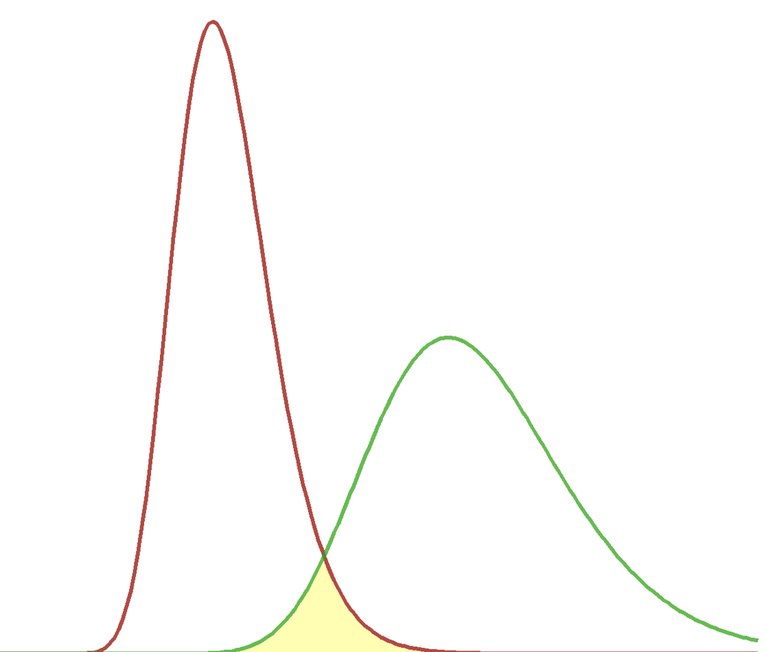
Latent Feature Vector Source Domain
Latent Feature Vector Source Domain
Predicted Source Domain Labels
Cross-Entropy Loss
Ground Truth Source Domain Labels
MMD-Loss
MMD-Loss
Latent Feature Vector Target Domain
Latent Feature Vector Target Domain
Predicted Target Domain Labels

Slide 7
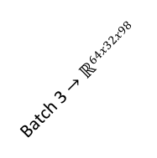
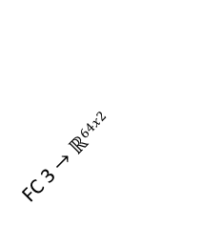
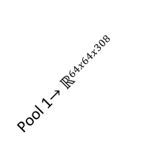
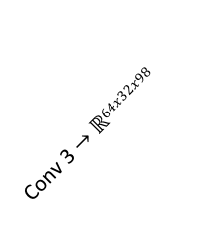
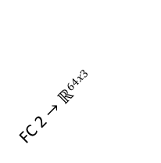
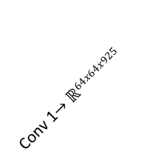
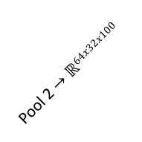
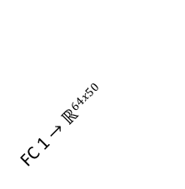
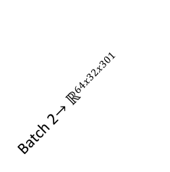
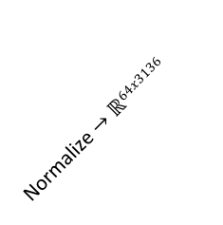
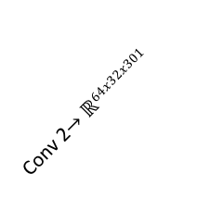
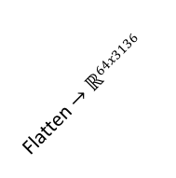
Normalize $→ℝ64x3136$
Flatten $→ℝ64x3136$
FC 1 $→ℝ64x50$
Batch 2$→ℝ64x32x301$
Conv 1$→ℝ64x64x925$
Conv 2$→ℝ64x32x301$
Conv 3 $→ℝ64x32x98$
FC 2 $→ℝ64x3$
Pool 1$→ℝ64x64x308$
Pool 2 $→ℝ64x32x100$
Batch 3 $→ℝ64x32x98$
FC 3 $→ℝ64x2$
Optimizer 1:
ADAM
Lr CNN: 1e-2
Lr FC: 1e-4
betas=(0.9, 0.999)
CE+GAMMA*MMD
Optimizer 2:
ADAM
Lr FC: 1e-2
betas=(0.9, 0.999)
CE

Slide 8
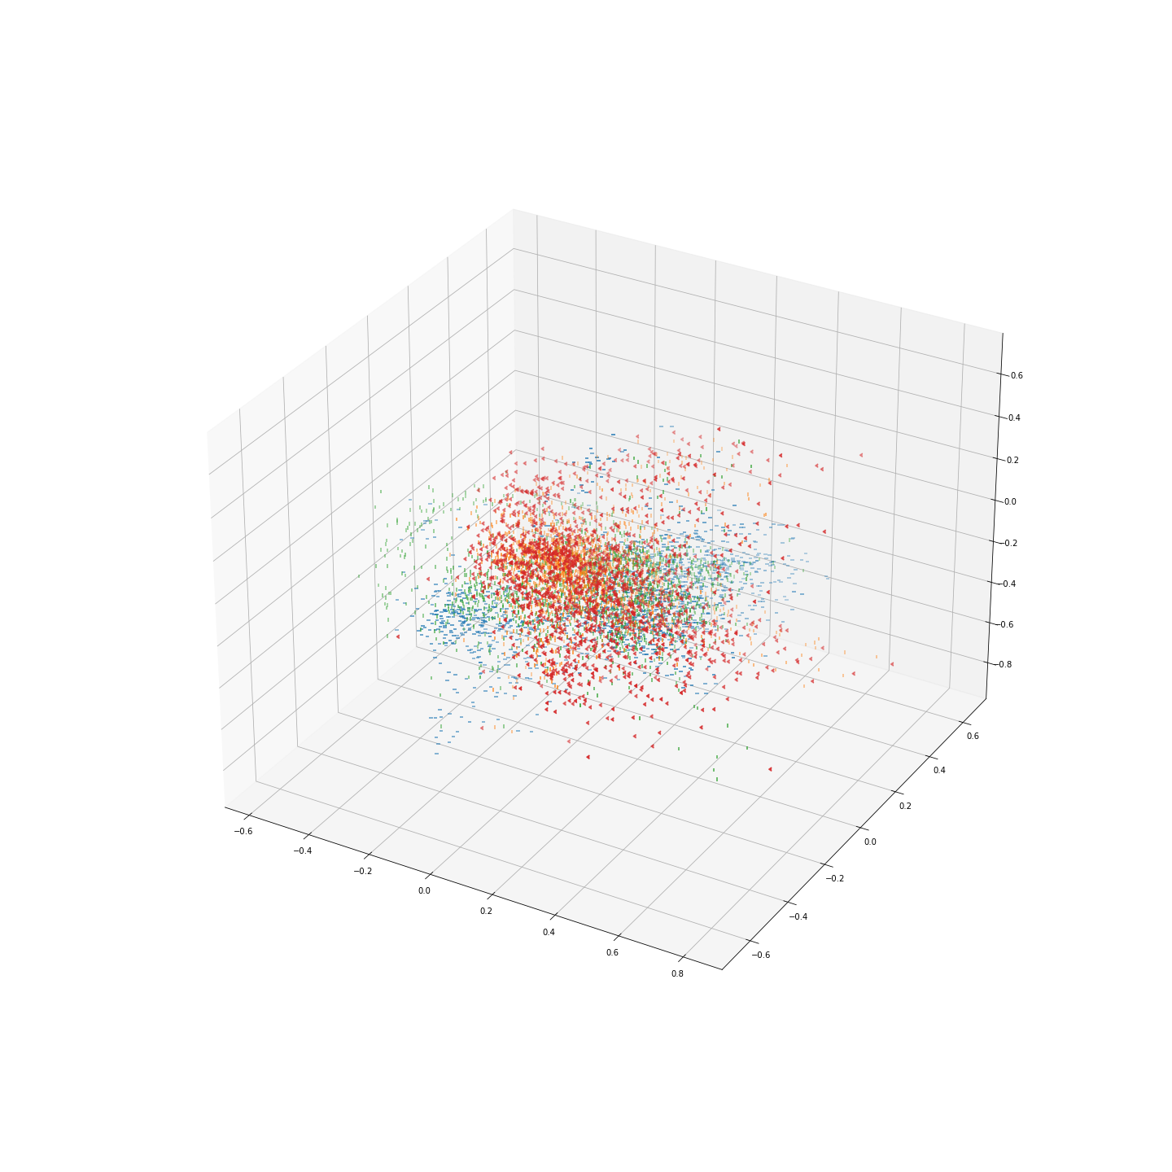
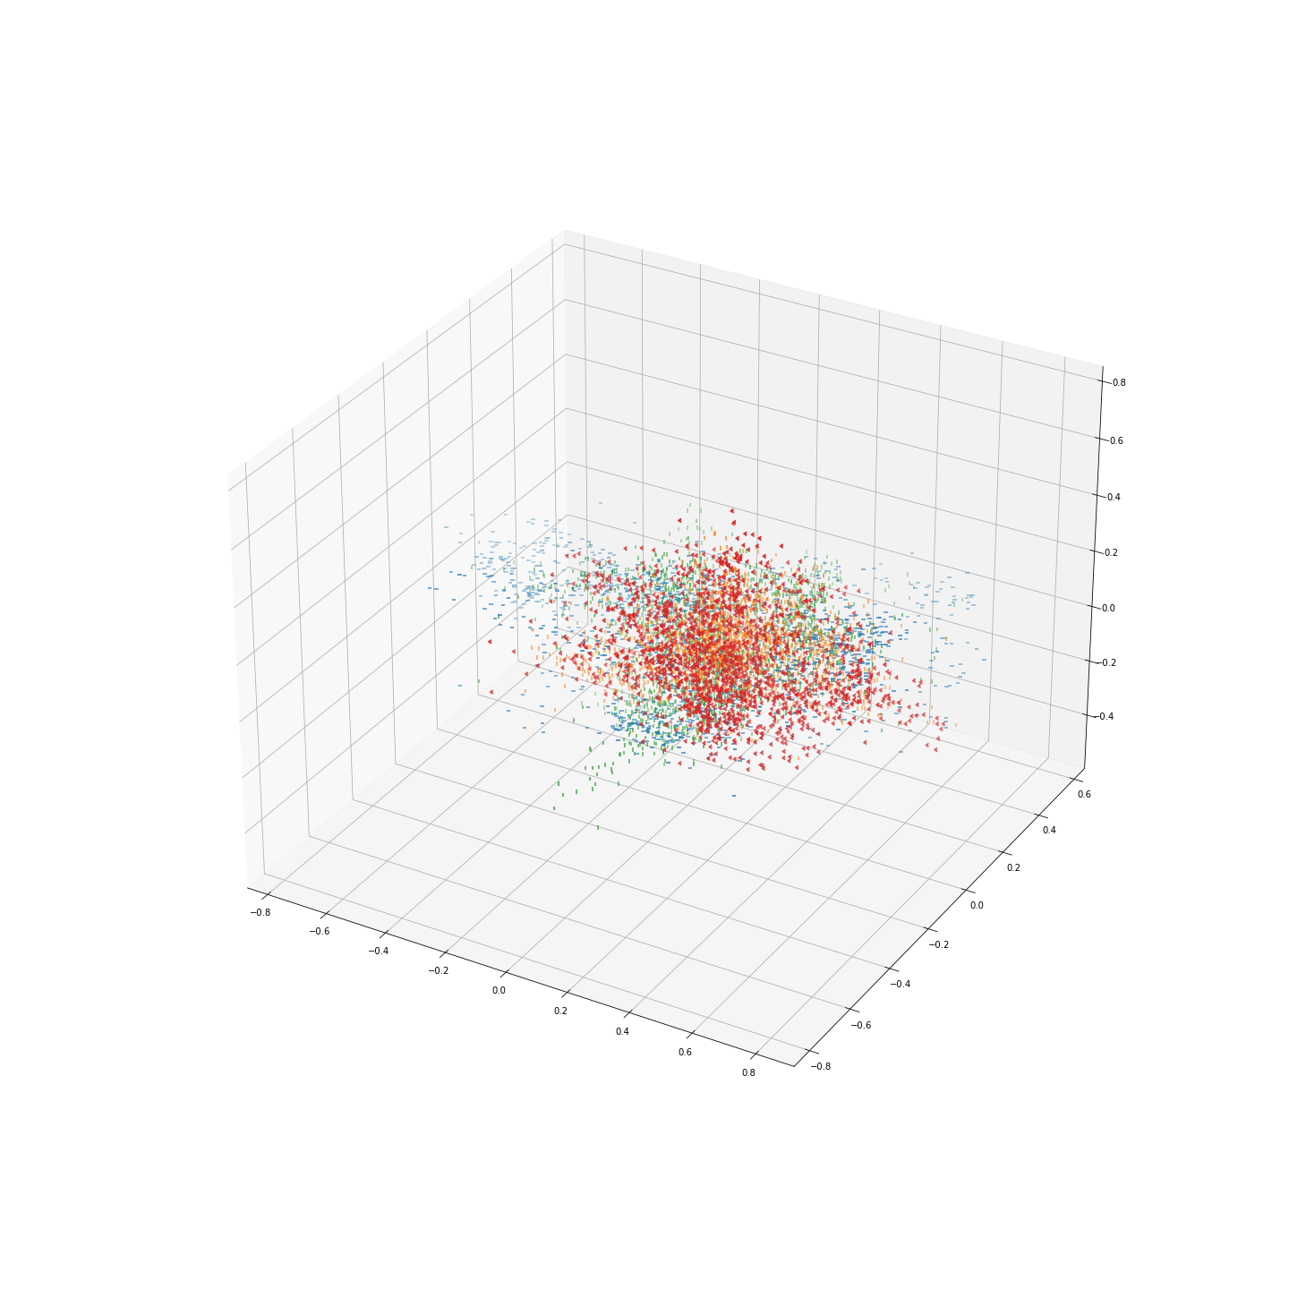
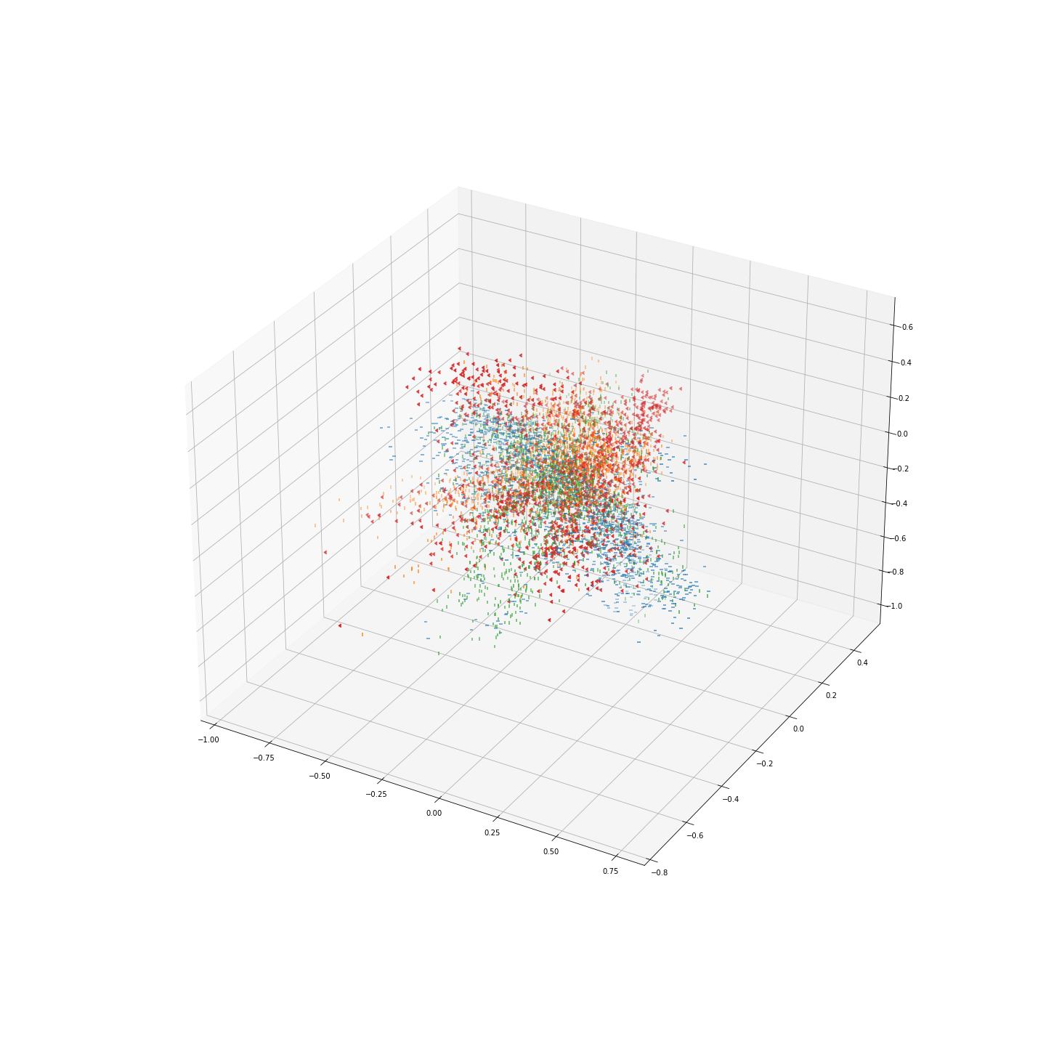
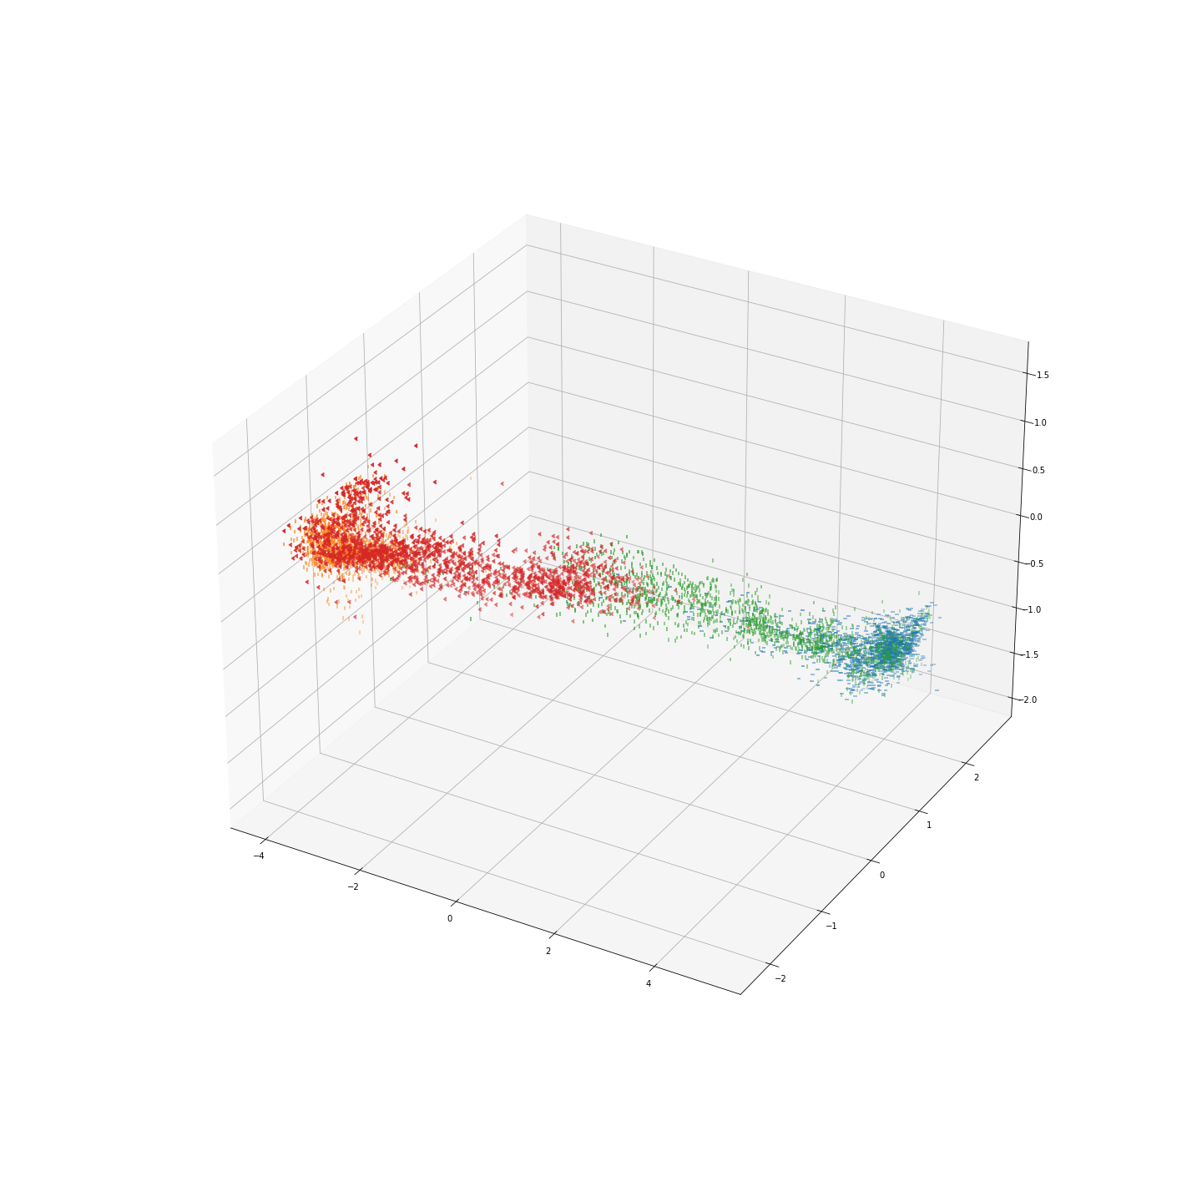
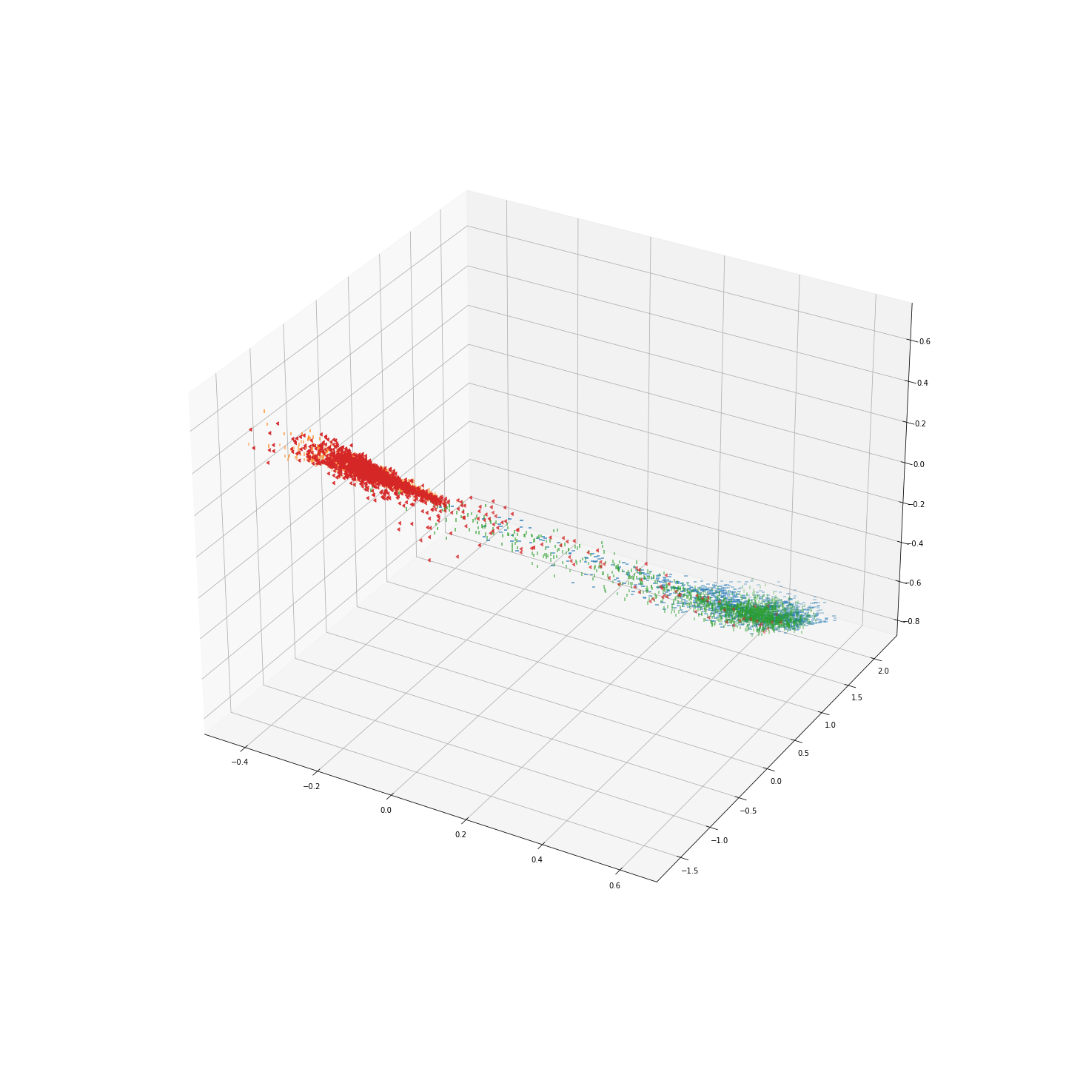
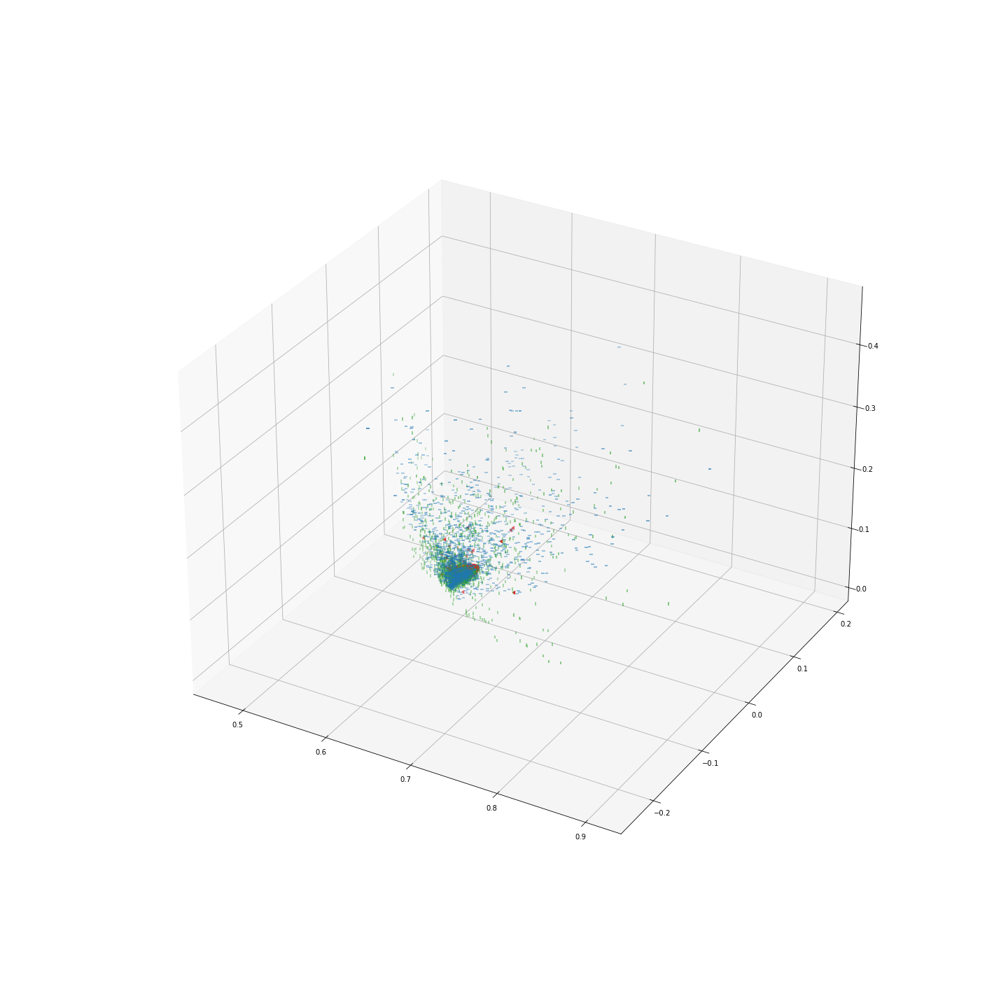
GAMMA = 0
GAMMA = 2.5
GAMMA = 10
Epoch 0
Epoch 6
Neuron 1 →

Slide 9
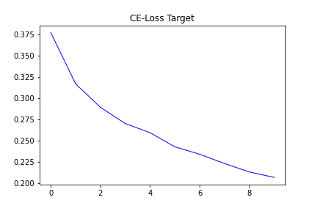
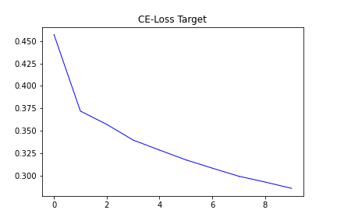
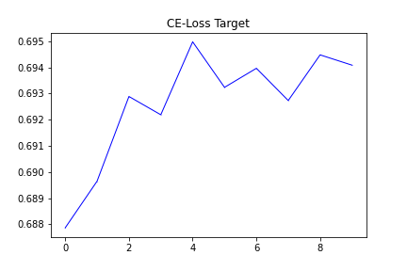
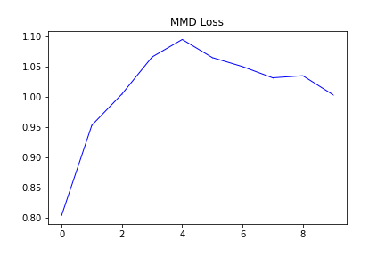
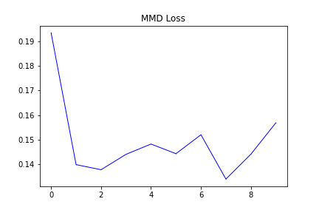
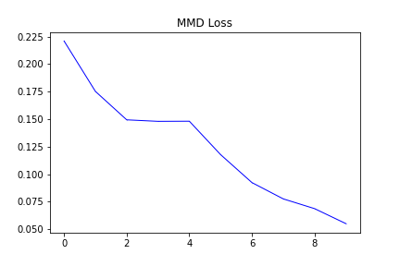


GAMMA = 0
GAMMA = 2.5
GAMMA = 10
CE-LOSS
CE-LOSS
CE-LOSS
MMD-LOSS
MMD-LOSS
MMD-LOSS

Slide 10
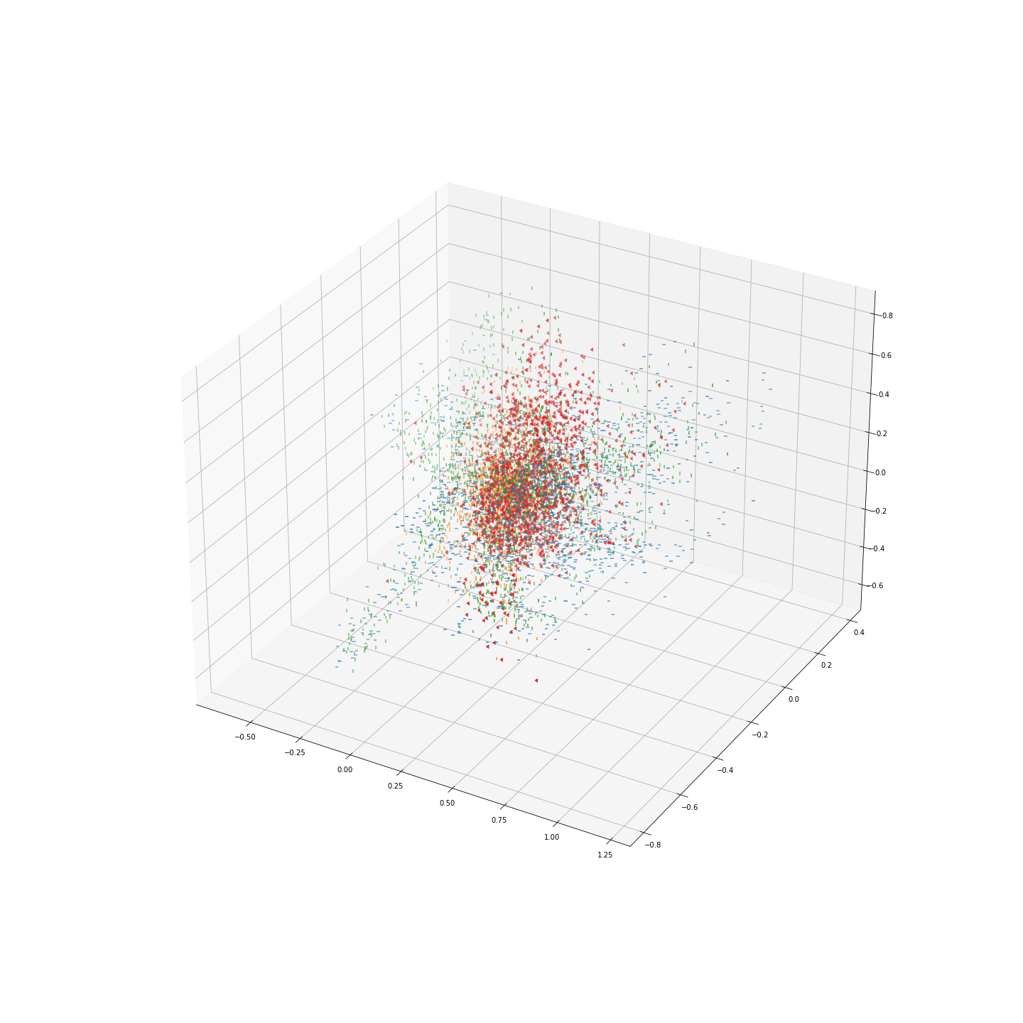
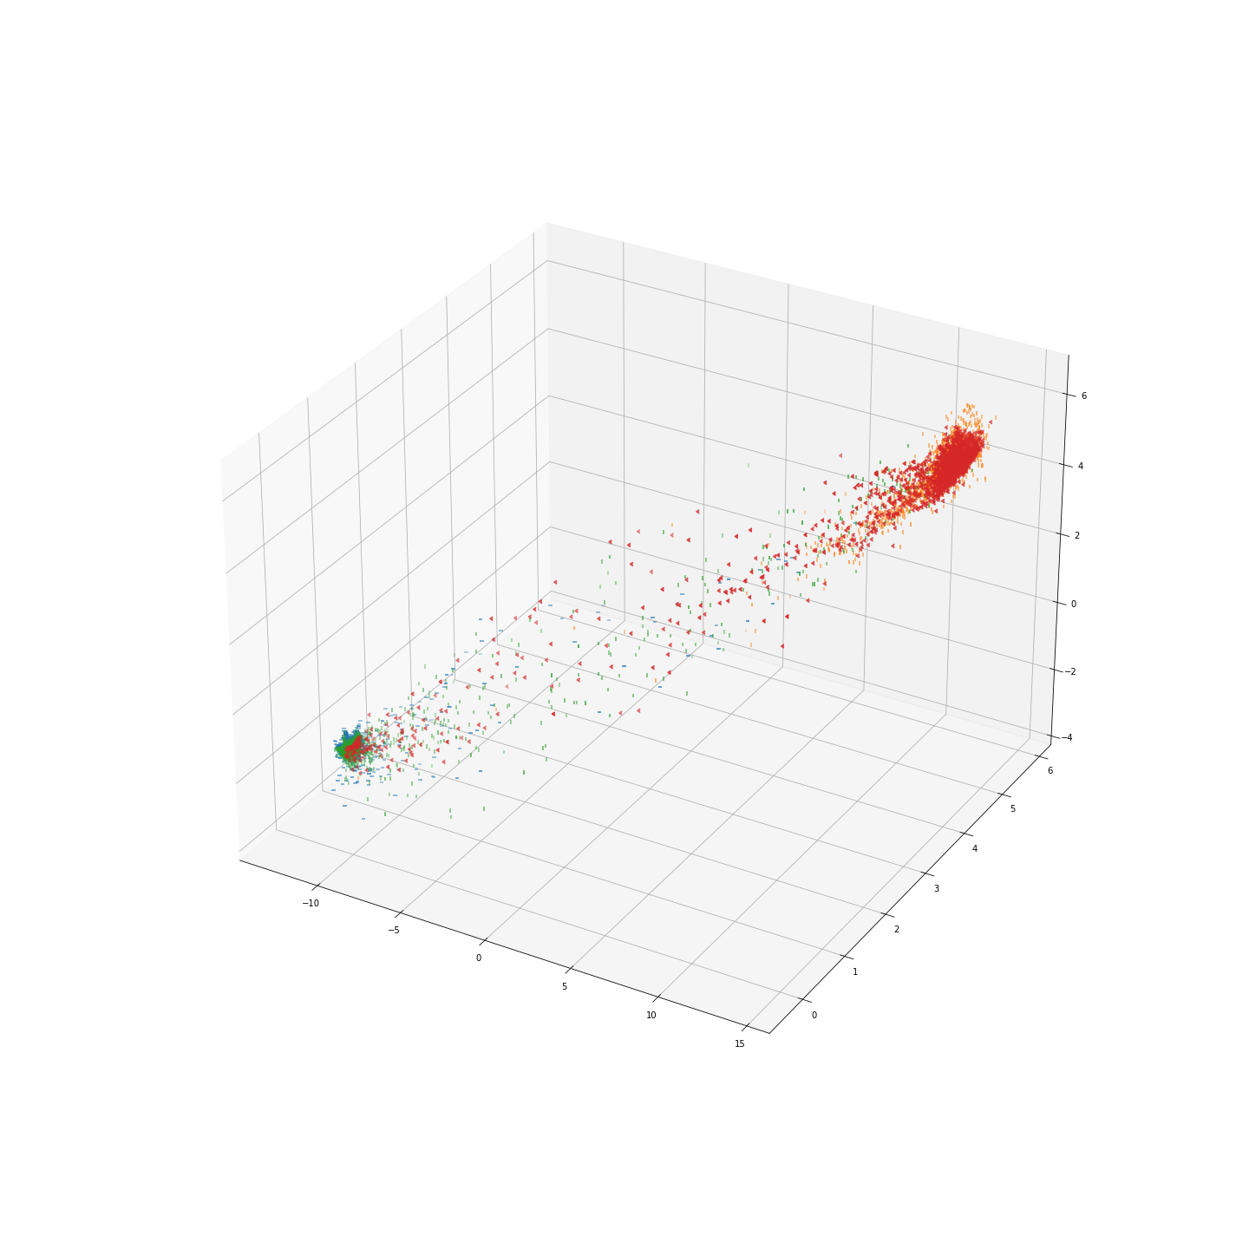
Unlabeled MMD loss
Labeled MMD loss
Epoch 0
Epoch 6

Slide 11

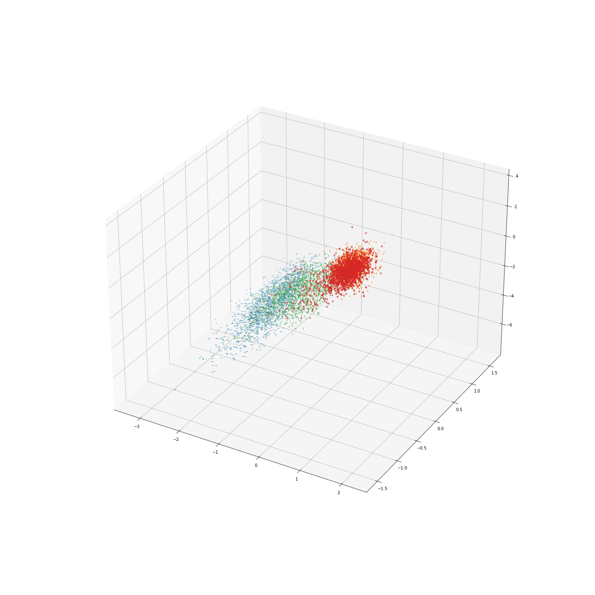
Unlabeled MMD Loss with target CE-Loss
Labeled MMD Loss
Epoch 0
Epoch 6

Slide 12
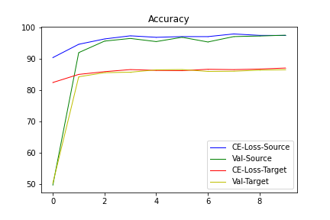
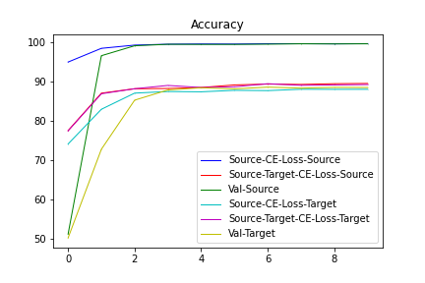

Slide 13
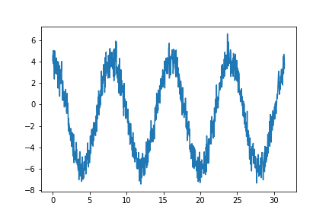
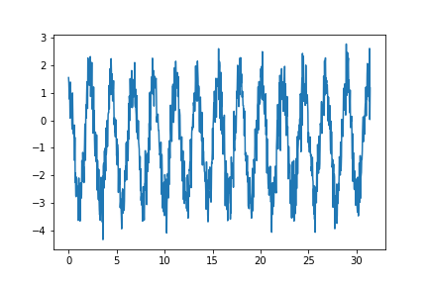
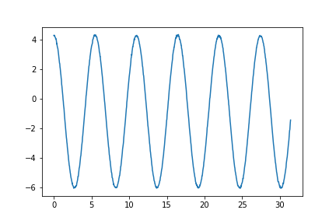
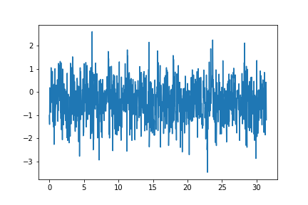
CLASS 0 DOMAIN 0
CLASS 1 DOMAIN 1

Slide 14
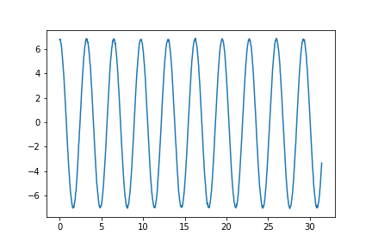
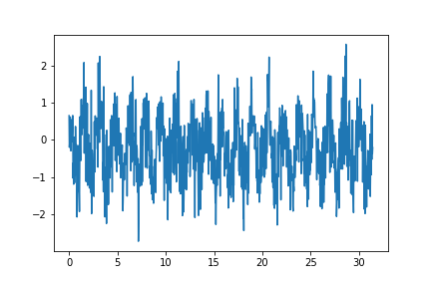
CLASS 0
CLASS 1
DOMAIN 0
DOMAIN 1

Slide 15
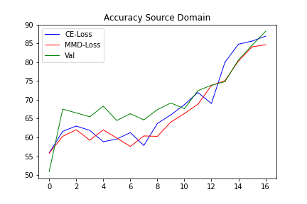
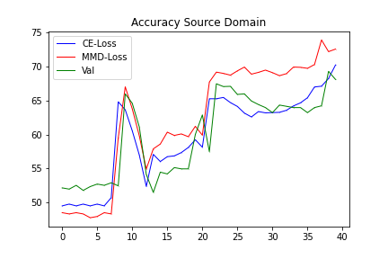
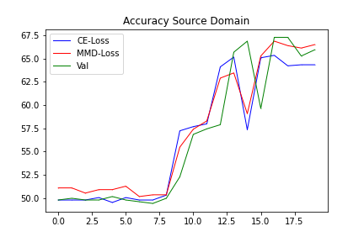
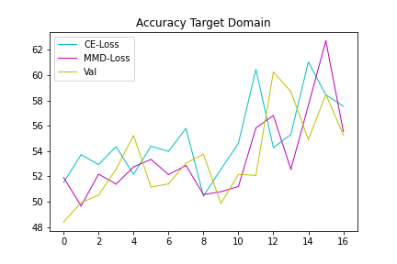
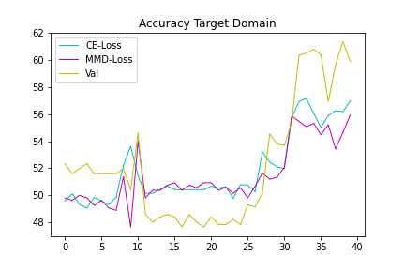
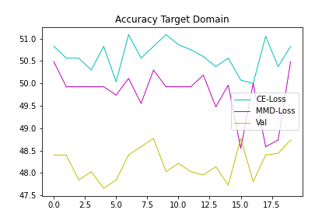
Regular MMD
Labeled MMD

Slide 16
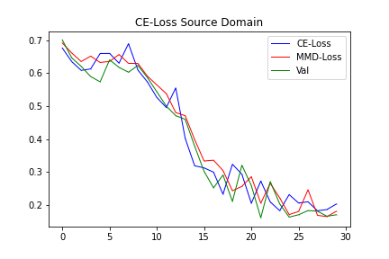
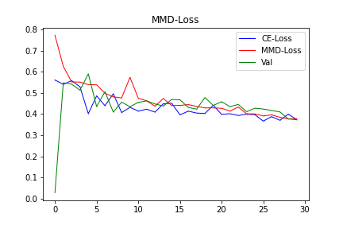

Slide 17
MAI | JUNI | JULI | AUGUST | SEPTEMBER
Beenden von MMD Versuchen | Experimente für Forschungsfragen überlegen | Vergleichen von Möglichkeiten | Schreiben von zweiter Methode | Finalisieren von Masterarbeit
Schreiben von MMD Kapitel |  |  | Schreiben von Einleitung | Präsentation
Einlesen in weitere Möglichkeiten |  |  | Schreiben von Conclusion | Puffer 2 Wochen
Lücken im Stand der Technik identifizieren |  |  | Schreiben von zweiter Methode | Verbessern von Verbesserungsvorschlägen
Forschungsfragen festlegen |  |  | Finalisieren von Masterarbeit

Slide 18
Weitere Möglichkeiten
Autoencoder for finding better latent feature space
LSTM CNN
Generative adversarial network (GAN)
Extensive preprocessing
Preprocessing to 2d images and using advanced 2D pretrained feature extractor (AlexNet, …)
Analysing features from data better
Instance-based instead of feature based domain adaption
Other special losses (contrastive loss, …)

Slide 19
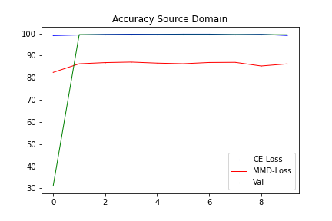
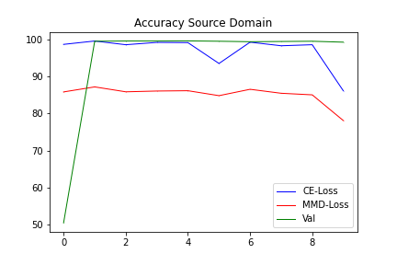
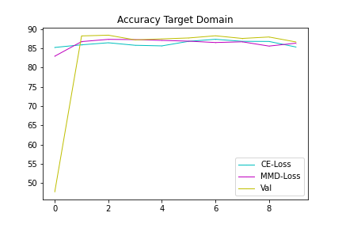
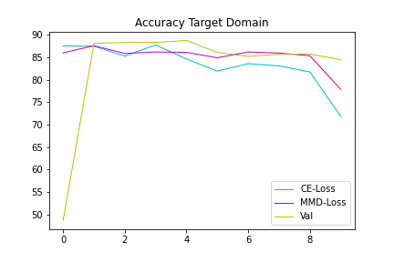
Regular FC & CNN MMD
Regular FC MMD

Slide 20
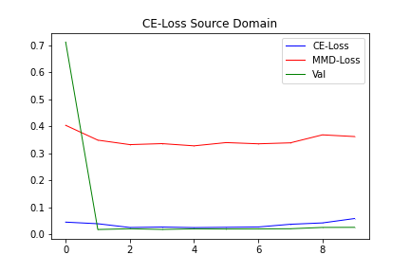



Regular FC & CNN MMD
Regular FC MMD

Slide 21
Regular FC & CNN MMD
Regular FC MMD
MMD-Loss
MMD-Loss
MMD-Loss
MMD-Loss
MMD-Loss
MMD-Loss
MMD-Loss
MMD-Loss
MMD-Loss
3x1x1000
64x1x901
64x1x300
32x1x293
32x1x293
32x1x97
32x1x95
32x1x95
1x1x3040
1x1x100
1x1x3
1x1x2
1x100
1x4
1x10
1x5
1x5
Conv
Max-Pool
Conv
Batch-Norm
Max-Pool
Conv
Batch-Norm
Flatten
FC
FC
FC
optimizer = torch.optim.Adam('params': model_cnn.parameters(), lr=1e-3, betas=(0.9, 0.999))

Slide 22




Regular FC & CNN MMD
Regular FC MMD

Slide 23




Regular FC & CNN MMD
Regular FC MMD

Slide 24






FC+CNN
FC
No mmd

Slide 25






FC+CNN
FC
No mmd

Slide 26
Input Layer
Hidden Layer
Hidden Layer
Output Layer

Slide 27


W_{1,j}
i₁
W_{2,j}
i₂
Activation Function
_{x}
$$φ$$
o_{j}
W_{3,j}
i₃
b_{j}

Slide 28







W_{1,j}
x₁
$w_{i,j}∗ x_{i}+b_{j}$
$$\frac{δy}{δw},\frac{δy}{δb}$$
W_{2,j}
y_{j}
x₂
_{x}
z$j$
$$φ$$
$$\hat{yj}$$
$$L$$
W_{3,j}
$$\frac{δ\hat{y}}{δy}$$
$$\frac{δL}{δ\hat{y}}$$
x₃
Activation Function
Loss
b_{j}

Slide 29

Flatten CNN Output
Input
Feature Map
Feature Map
Feature Map
Output
Convolution
Convolution
Convolution
Flatten
FC

Slide 30
1
0
1
0
1
0
0
1
1
1
0
1
0
1

Slide 32
1
5
1
4
1
6
Stride = 2
2
1
1
1
1
1
9
7
9
1
1
2
1
2
1
7
8
6
4
1
1
4
1
2
5
6
9
1
2
1
1
7
1
1
1
1
3
0
1
1
1
1
1
1
1
5
1
1
1
2
4
8
4
4
5
8
1
1
1
1
1
1
8
4
4
5
8
5
1
1
1
3
1
8
4
4
5
5
1
1
3
1
3
1
8
5
5
8
8
6
1
1
1
1
3
9
6
6
6
8
Stride = 1

Slide 33
MAX-pooling
1
5
1
4
1
6
Stride = 2
2
1
1
1
1
1
5
4
6
1
1
2
1
2
1
4
4
2
4
1
1
4
1
2
2
3
7
1
2
1
1
7
1
1
1
1
3
0
1
1
1
1
1
1
1
5
1
1
1
2
4
1
1
1
1
1
1
2
1
2
5
1
1
1
3
1
2
1
1.5
2.25
1.5
2
1
1
3
1
3
1
6
1
1
1
1
3
Stride = 2
AVG-pooling

Slide 34
Dilation = 2
1
5
1
4
1
6
5
11
6
12
2
1
1
1
1
1
8
7
4
8
1
1
2
1
2
1
5
5
12
4
4
1
1
4
1
2
7
9
3
10
1
2
1
1
7
1
1
1
1
3
0
1
1
1
1
1
1
1
5
1
1
1
2
4
8
4
4
5
8
1
1
1
1
1
1
8
4
4
5
8
5
1
1
1
3
1
8
4
4
5
5
1
1
3
1
3
1
8
5
5
8
8
6
1
1
1
1
3
9
6
6
6
8
Dilation = 1

Slide 35
Zero padding = 1
0
0
0
0
0
0
1
2
2
2
1
0
1
1
1
1
0
2
5
5
5
3
0
1
2
1
2
0
2
5
4
4
3
0
1
1
0
1
0
3
5
3
9
8
0
2
1
1
7
0
2
3
2
8
7
0
0
0
0
0
0
1
1
1
2
4
4
5
1
1
1
1
4
4
6
1
1
1
3
6
6
8
1
3
1
3
Zero padding = 0

Slide 36
0
1
0
0
1
1
1
1
1

Slide 37
0
1
0
0
1
1
1
1
1

Slide 38
Data
Training
Model
Label
Class 1
Model 1
Task 1
Class 2
Transfer Learning
Transfer Knowledge
Class 3
Model 2
Task 2
Class 4
Training
Source Domain
Model 1
Domain Adaptation
Class 1
Transfer Knowledge
Class 2
Target Domain
Model 2

Slide 39
Start of Test Cycle N=0
Warm Up (60min)
Constant Speed
Direction Change
Reheating (2min)
N=N+1
Sine Sweep
N=10?
No
Yes
End of Test Cycle

Slide 40
Frequency →
Time →

Slide 41


















Positive Phase
Negative Phase
Visible Unit
Hidden Unit
Visible Unit
Hidden Unit
W_{1,1}
x
W_{1,1}
+ b₁
$$h_{1}^{t=0}$$
$$h_{1}^{t=0}$$
$$v_{1}^{t=1}$$
x
$$v_{1}^{t=0}$$
+ a₁
x
+ b₂
$$h_{2}^{t=0}$$
$$h_{2}^{t=0}$$
$$v_{2}^{t=0}$$
x
$$v_{2}^{t=1}$$
+ a₂
x
+ b₃
$$h_{3}^{t=0}$$
$$h_{3}^{t=0}$$
$$v_{3}^{t=0}$$
x
$$v_{3}^{t=1}$$
+ a₃
x
+ b₄
$$h_{4}^{t=0}$$
$$h_{4}^{t=0}$$
$$\text{W}∈ℝ^{3x4}$$
$$\text{b}∈ℝ^{4}$$
$\text{a}∈$ $ℝ^{3}$
$$\text{W}∈ℝ^{4x3}$$

Slide 42
RBM 1
RBM 2
Classifier
Visible Unit
Hidden Unit
Visible Unit
Hidden Unit
Labels

Slide 43
output
h⁽³⁾
h⁽³⁾
RBM
h⁽²⁾
h⁽²⁾
h⁽²⁾
RBM
h⁽¹⁾
h⁽¹⁾
h⁽¹⁾
h⁽¹⁾
RBM
v
v
v
v
RBM for v
RBM for h₁
RBM for h₂
DBN Structure

Slide 44
x6
8
3
5
3
6
3
3
5
8

Slide 45







Pre-Trained Model
Adversarial Training
Sample ${\{x_{i}^{s},y_{i}^{s}\}}_{i=1}^{m}$ and ${\{x_{i}^{t}\}}_{i=1}^{m}$ from the Source Dataset $X^{s}$ and Target Dataset $X^{t}$
Pre-Training
Yes
No
Training over?
Update Parameters $θ_{D}$ by Maximizing the Adversarial Loss in 3.16
Update Parameters $θ_{M}$ and $θ_{C}$ by Minimizing the Source Eross Entropy Loss in 3.15
Update Parameters $θ_{F}$ by Minimizing the Source Cross Entropy and Adversarial Loss in 3.15 and 3.16
Sample${\{x_{i}^{s},y_{i}^{s}\}}_{i=1}^{m}$from the Source Dataset $X^{s}$
Training over?
No
Yes
Deep Model Architecture
Deep Domain Invariant Feature
{${x_{i}^{t}\}}_{i=1}^{m}$from Target Dataset $X^{t}$
Deep Transfer Diagnosis Model WDMAN
Output Diagnosis Result ${\{y_{i}^{t}\}}_{i=1}^{m}$

Slide 46
Fault Diagnosis
Filtering DWT
Save
File.txt
Signal Acquisition
Signal Analysis
Fault Identification (Alarming)
Fault Estimation
RPM

Slide 47
Average
Average
Motor
Current
Trigger
Time
Window
FFT
Auto
Spectrum
Average
Average
Cross
Spectrum
FRF
Average
Average
Motor
Current
Trigger
Time
Window
FFT
Auto
Spectrum

Slide 48












$$k_{shaft}^{rot}$$
$$θ_{m}$$
$$θ_{b}$$
$$T$$
J_{m}
J_{s}
$$c_{rot}$$
$$β=\frac{l}{2π}$$
$$k_{nut}$$
$$x_{t}$$
$$k_{shaft}^{ax}$$
m_{t}
$$x_{b}$$
$$c_{nut}$$
m_{b}
$$c_{ax}$$

